Slide 1

Looking back at my R journey <-
Rahul Venugopal
PhD Scholar
Center for Consciousness Studies
NIMHANS, Bengaluru, India

Slide 2
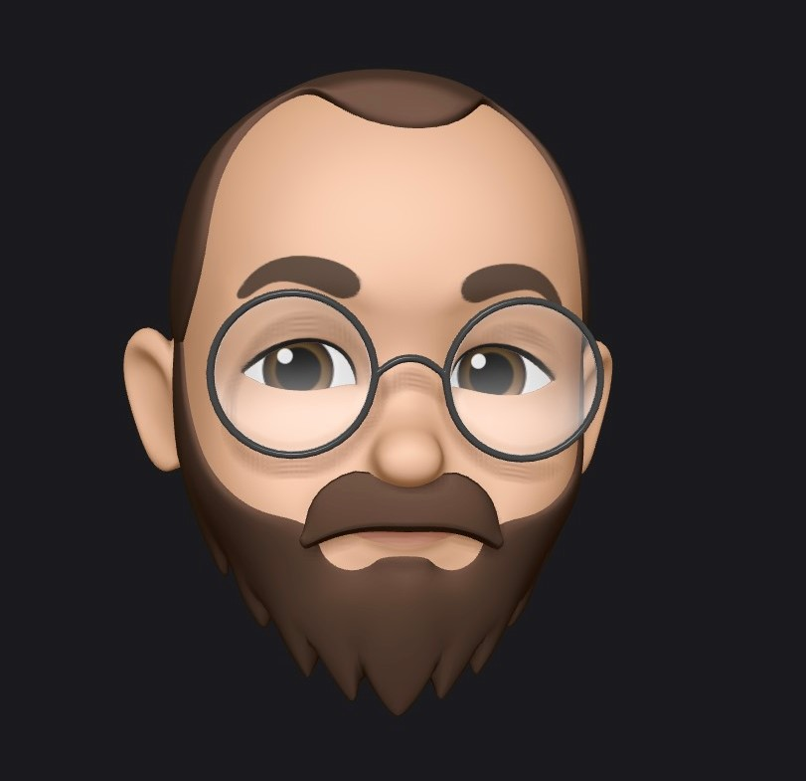
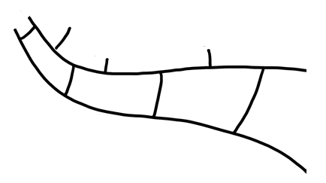

Engineer
Neuroscience researcher
School teacher
Associate software engineer
Career coach Aptitude trainer
Education start-up
Journey cartoon inspired by Heidi Seibold’s talk slide

Slide 3

How was your R journey?
Why was my journey so rough?

Slide 4
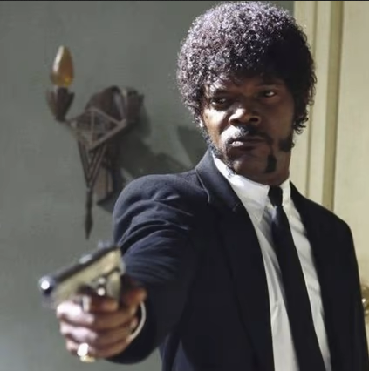


Don’t assume
Setting path
Installing library
Naming conventions
Tidy format
etc
etc
etc
Say ‘programming is easy’ one more time
How to start an ‘automatic start’ scooter?

Slide 5
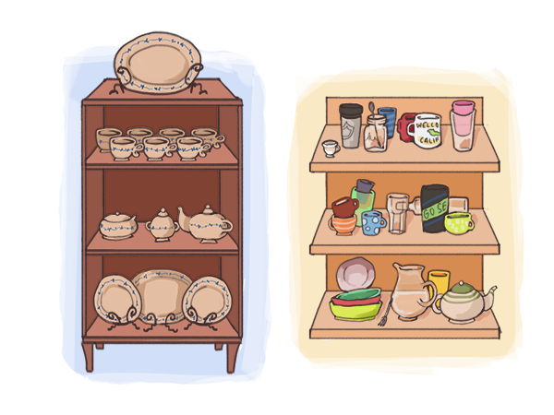
Base R vs Tidyverse vs Both
Notes:
Purists vs Pragmatists

Slide 6

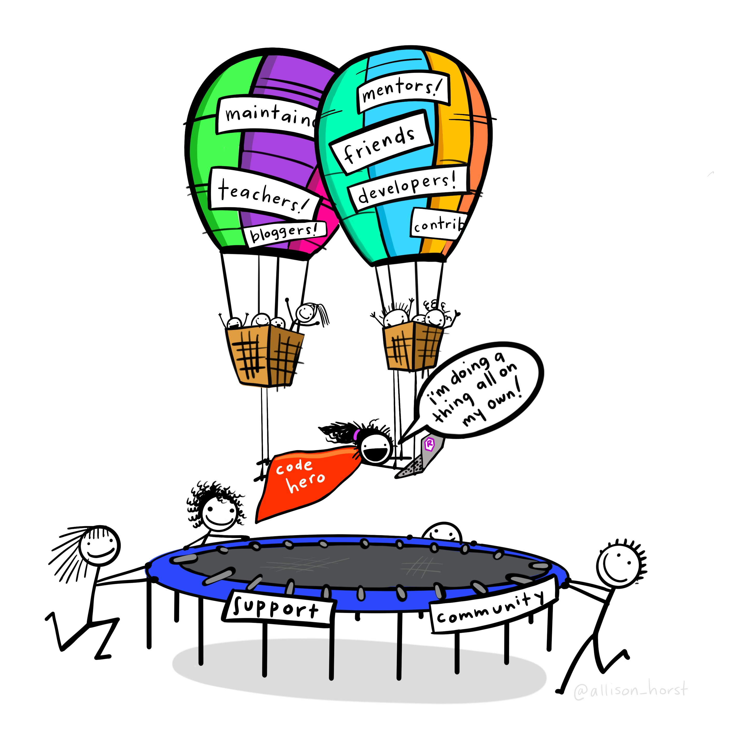
R & stats illustrations by @allison_horst

Slide 7
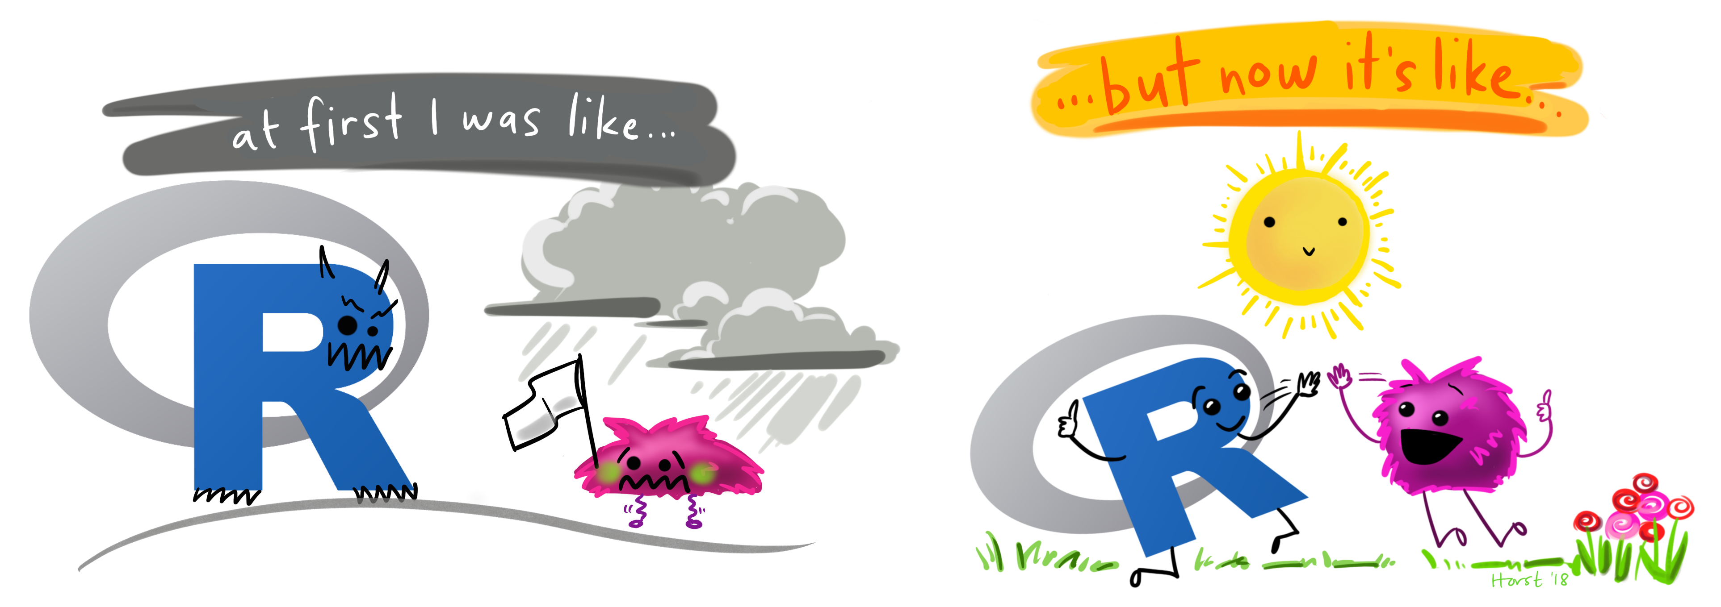
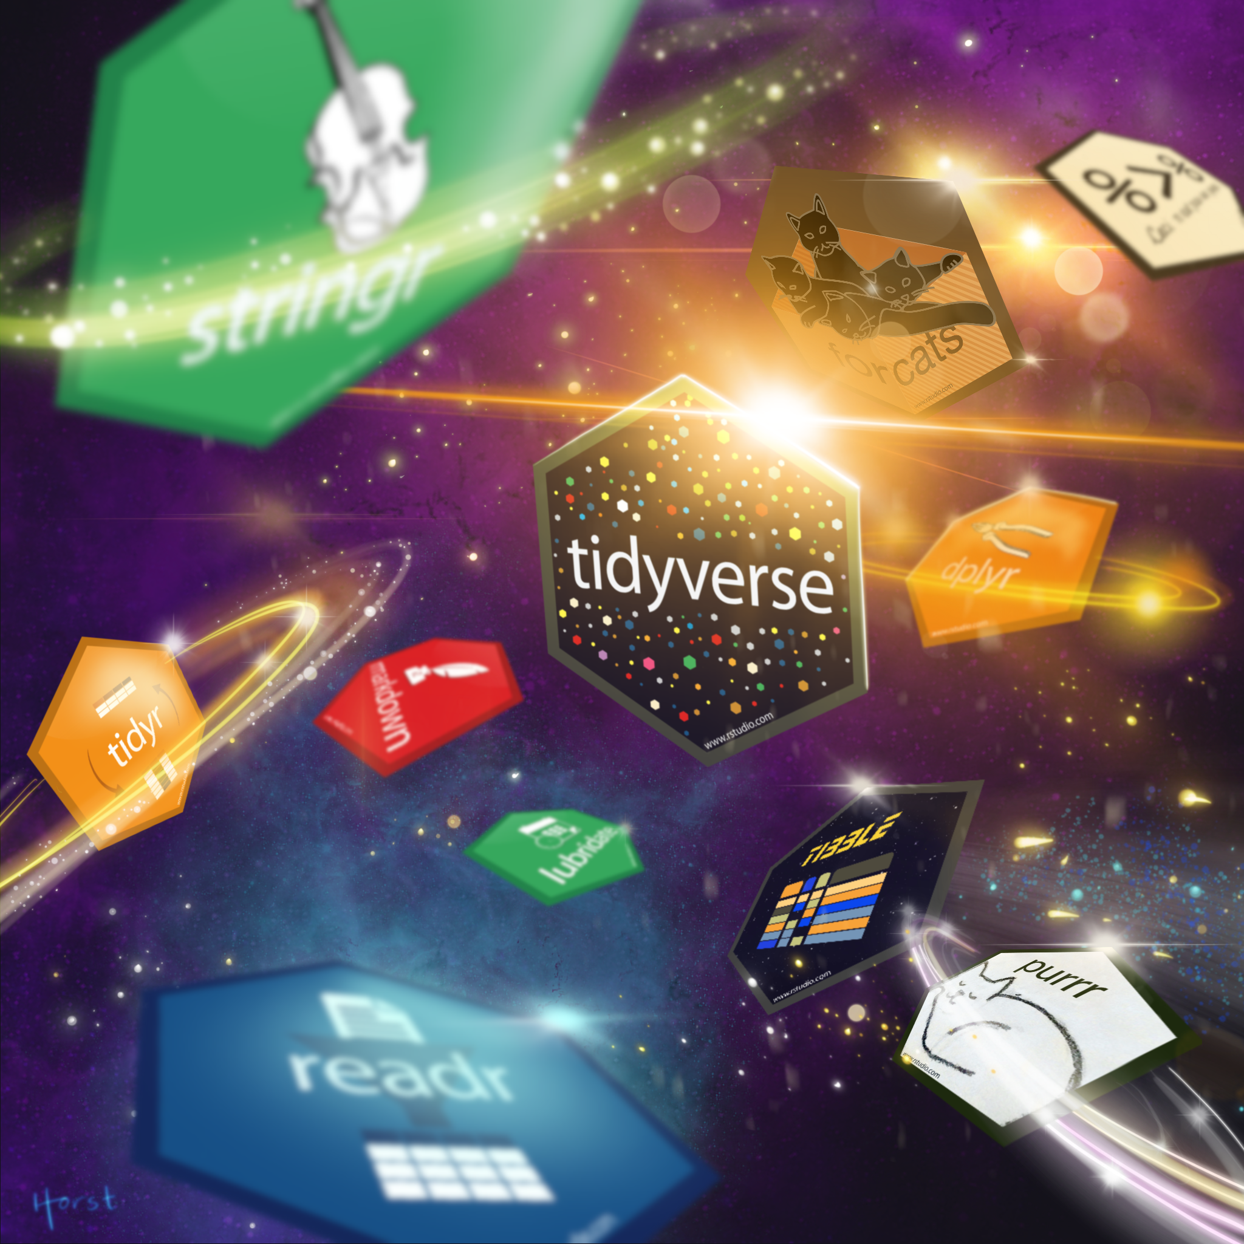

Slide 8
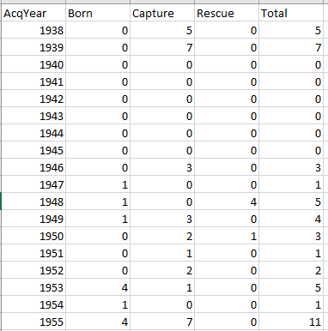
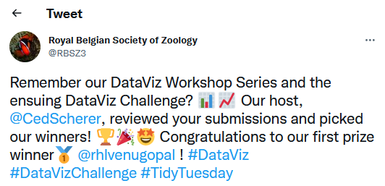

Example based learning – Demo 1
save_cetaceans repo

Slide 9
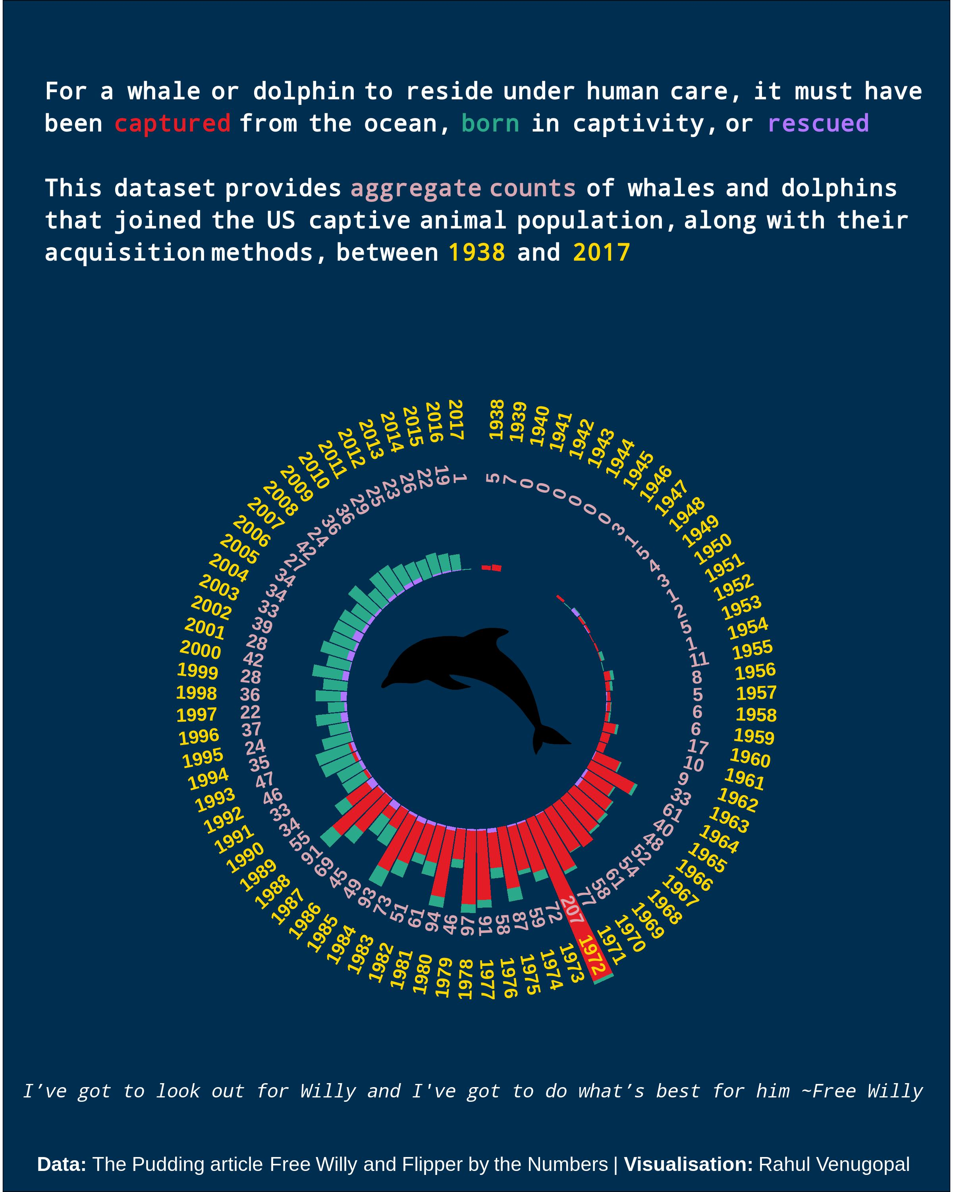
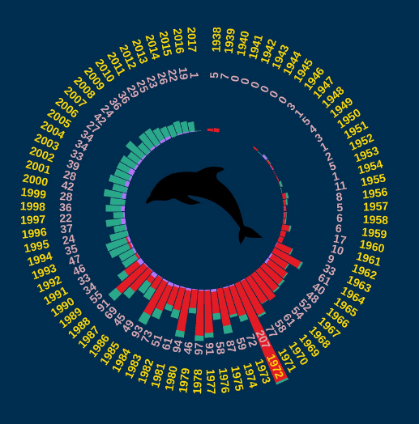

Slide 10
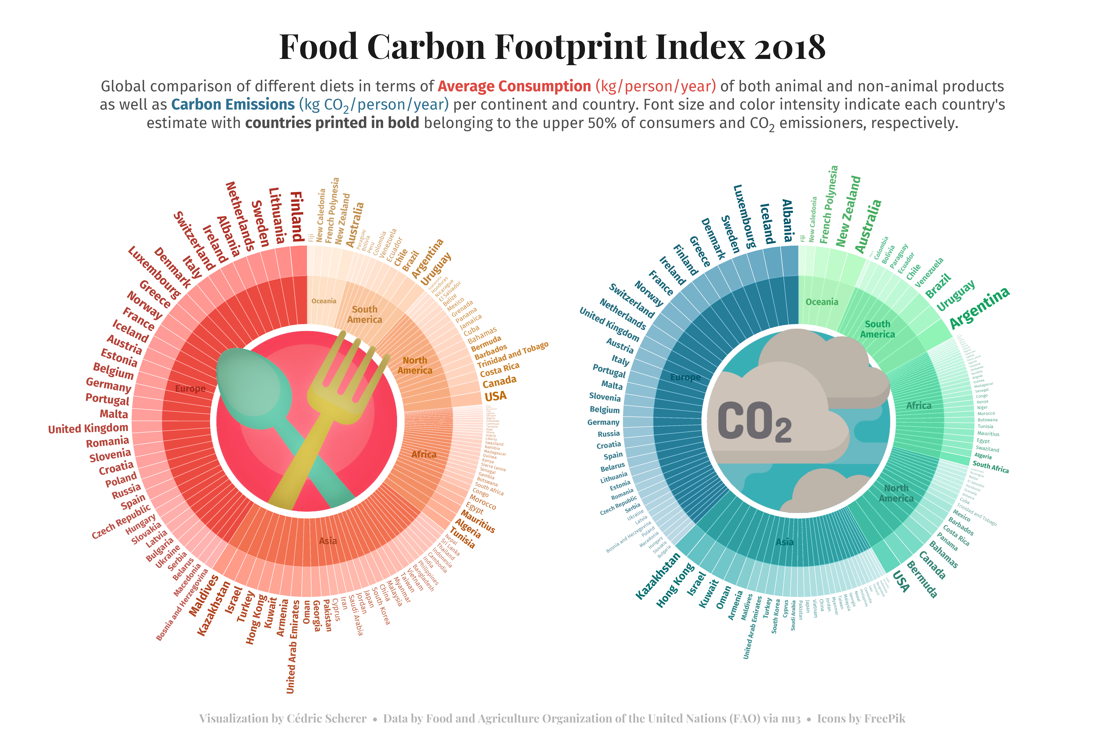
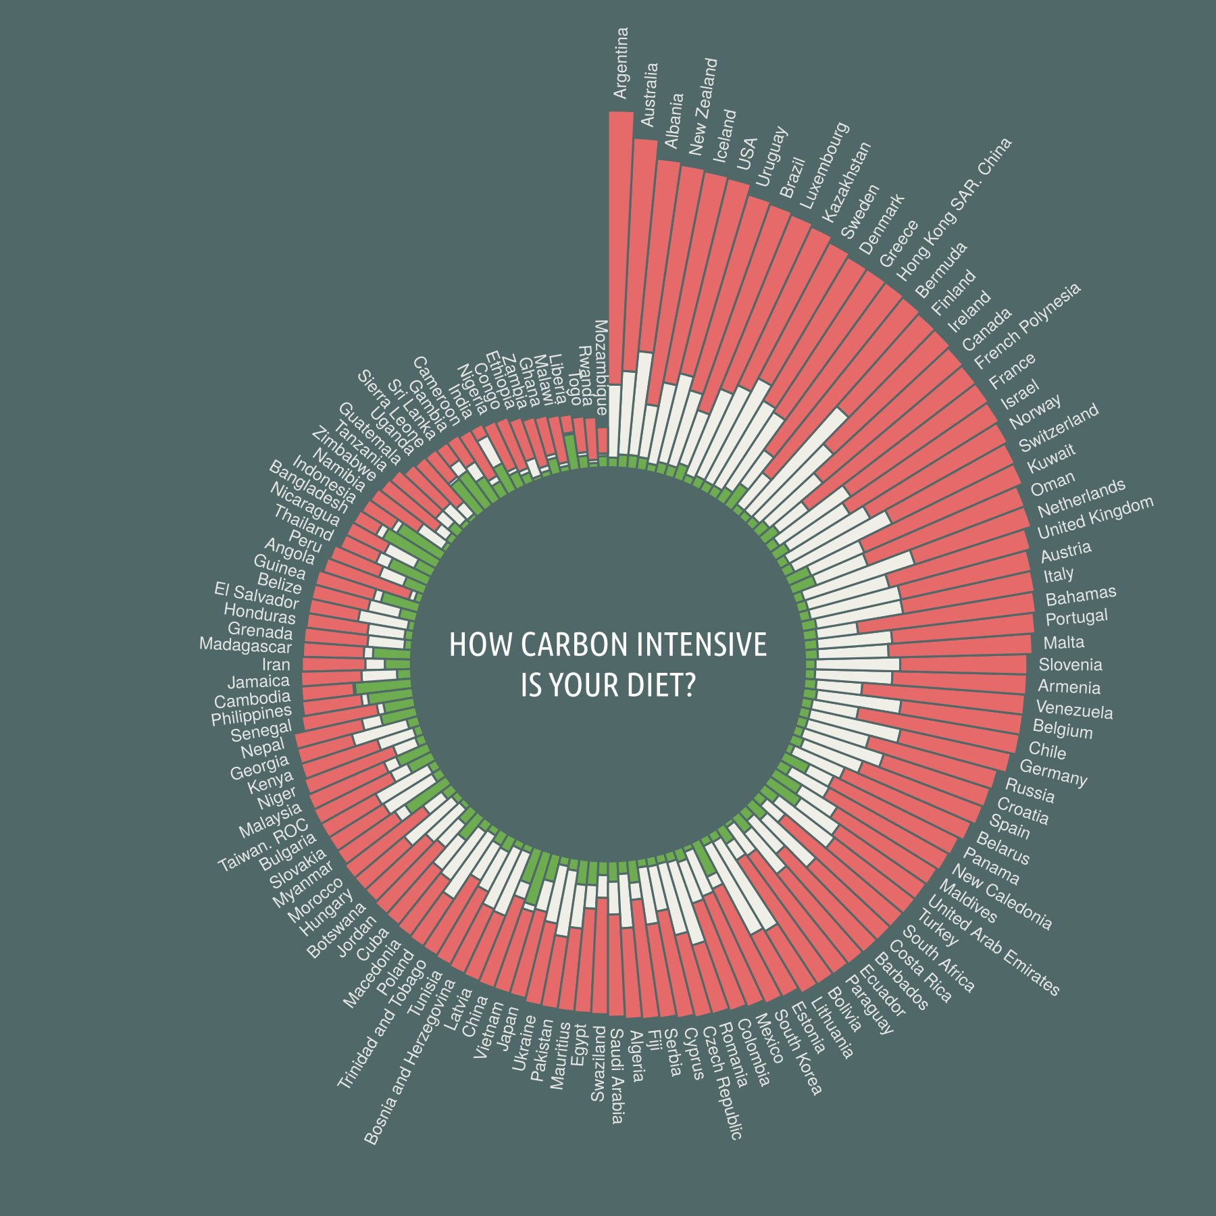
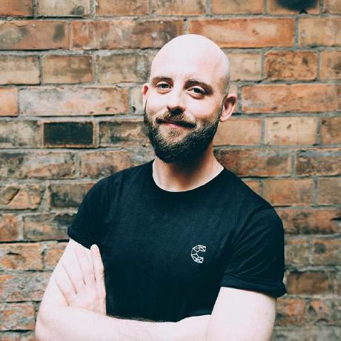
Inspiration
https://github.com/z3tt
Jake Lawlor and Art Poon

Slide 11
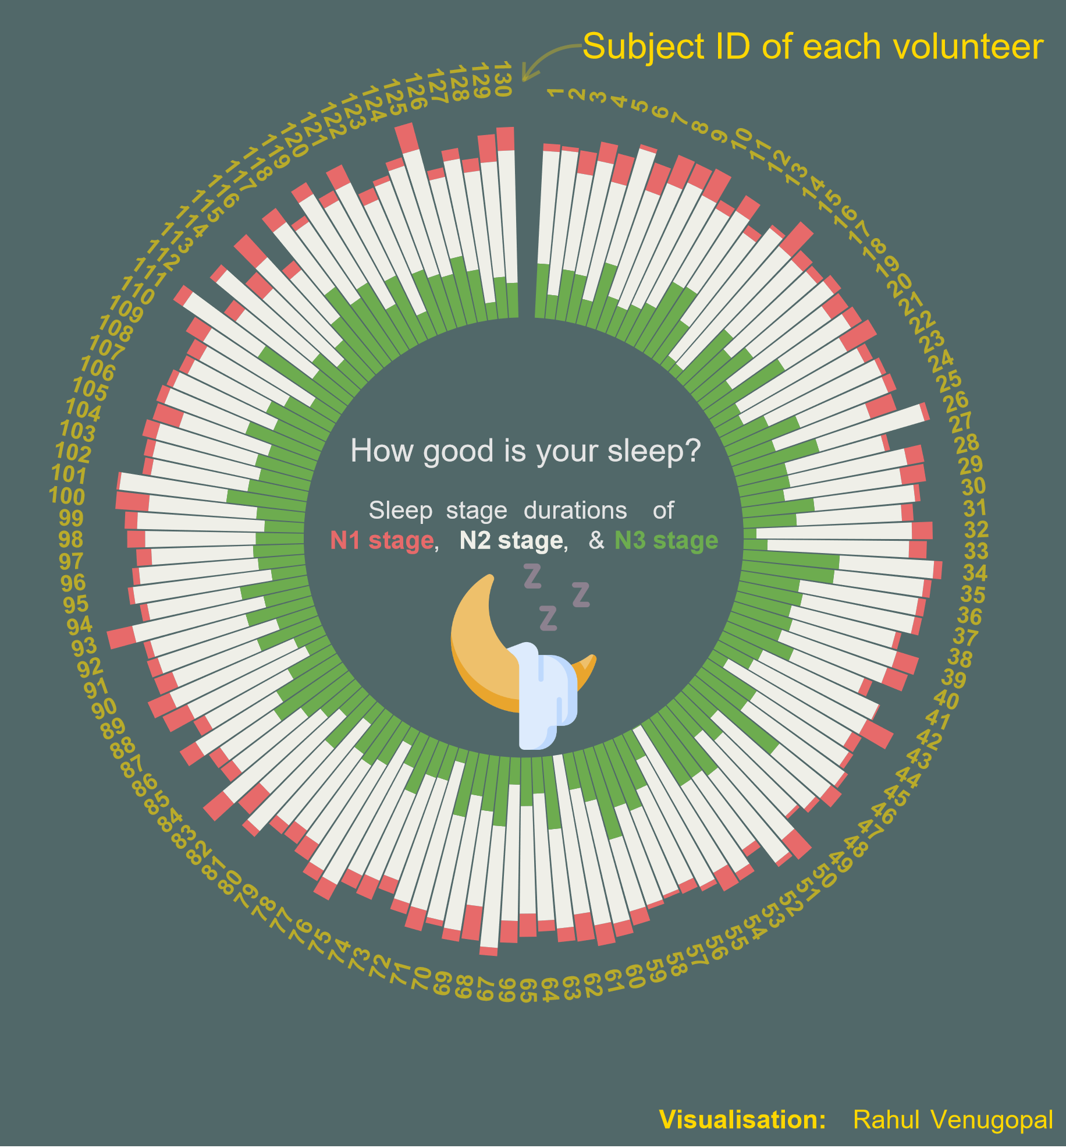
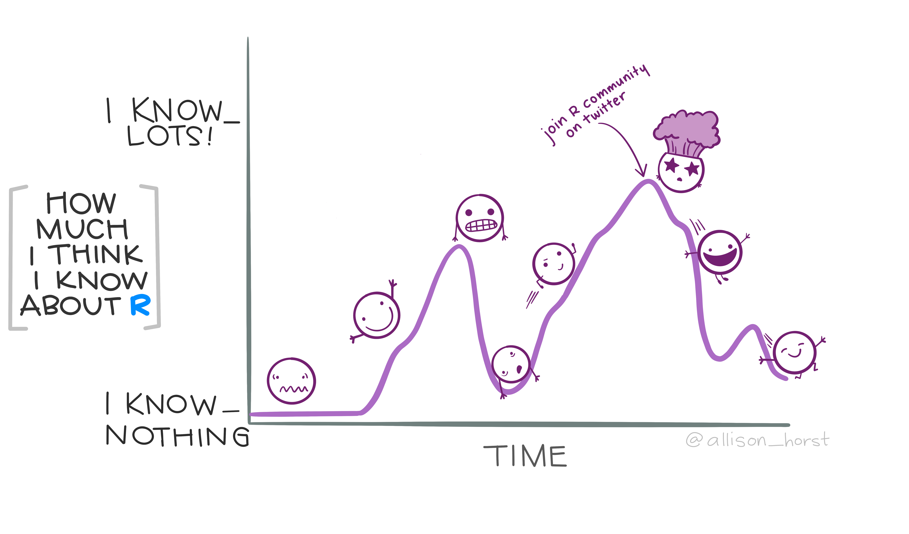

Slide 12
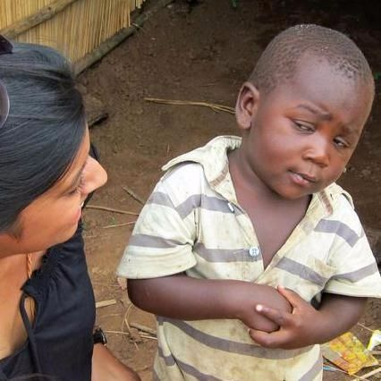
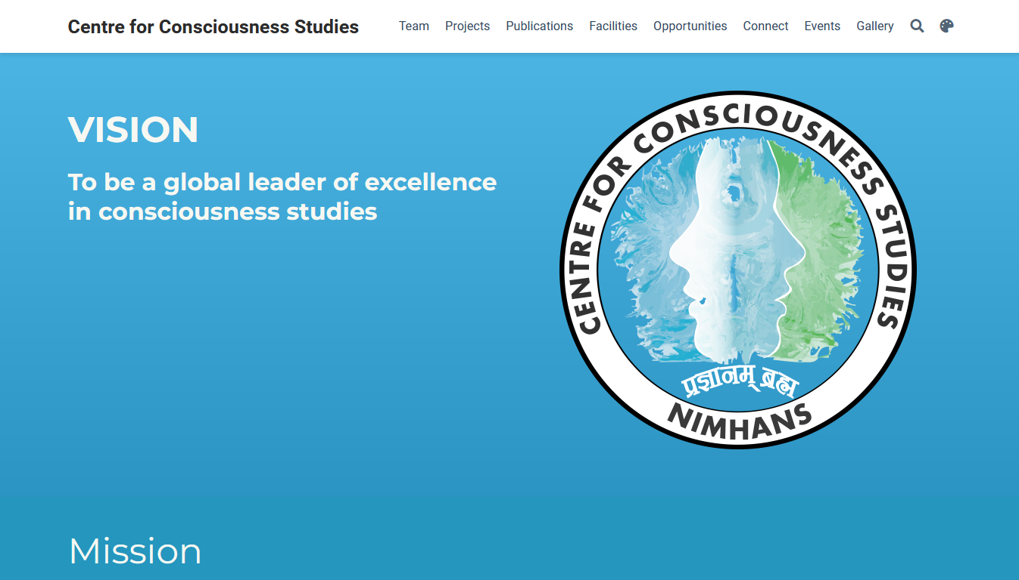
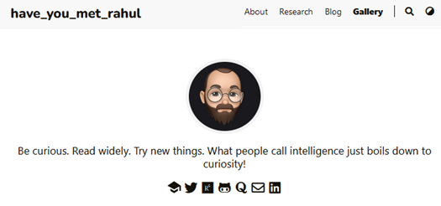
Using R and Rstudio to do non-statistical stuff
So, you can use R to
create websites ah?

Slide 13
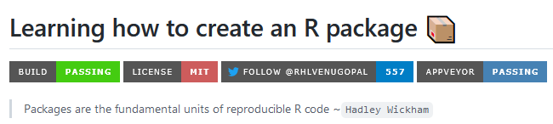
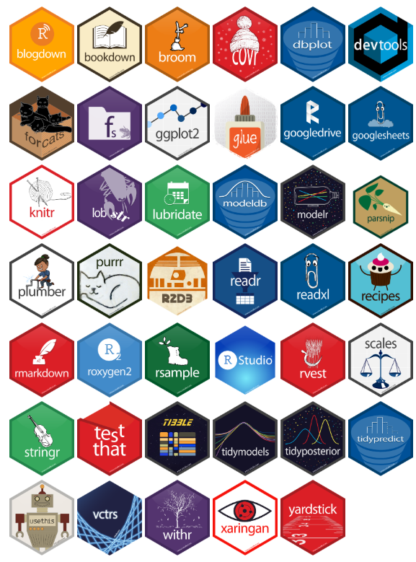
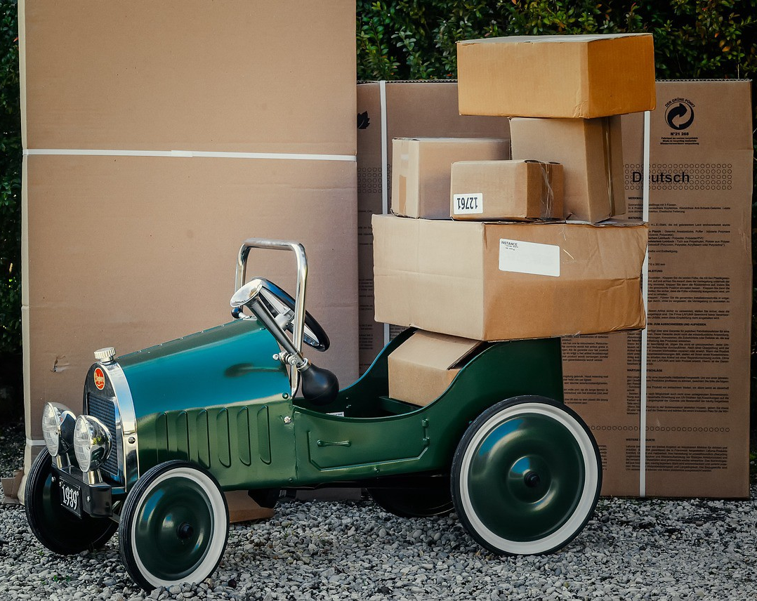

Slide 14
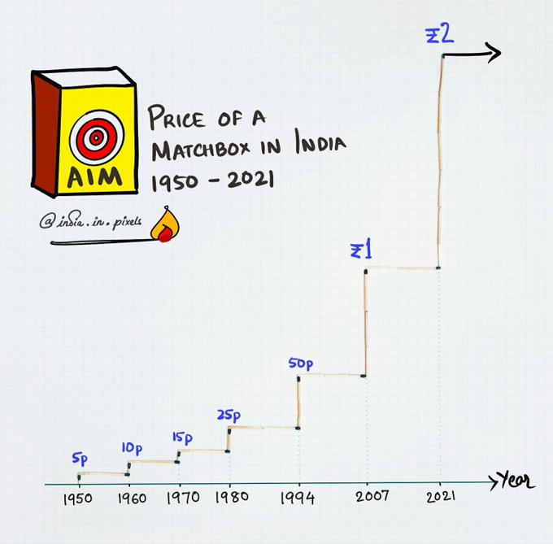

Slide 15
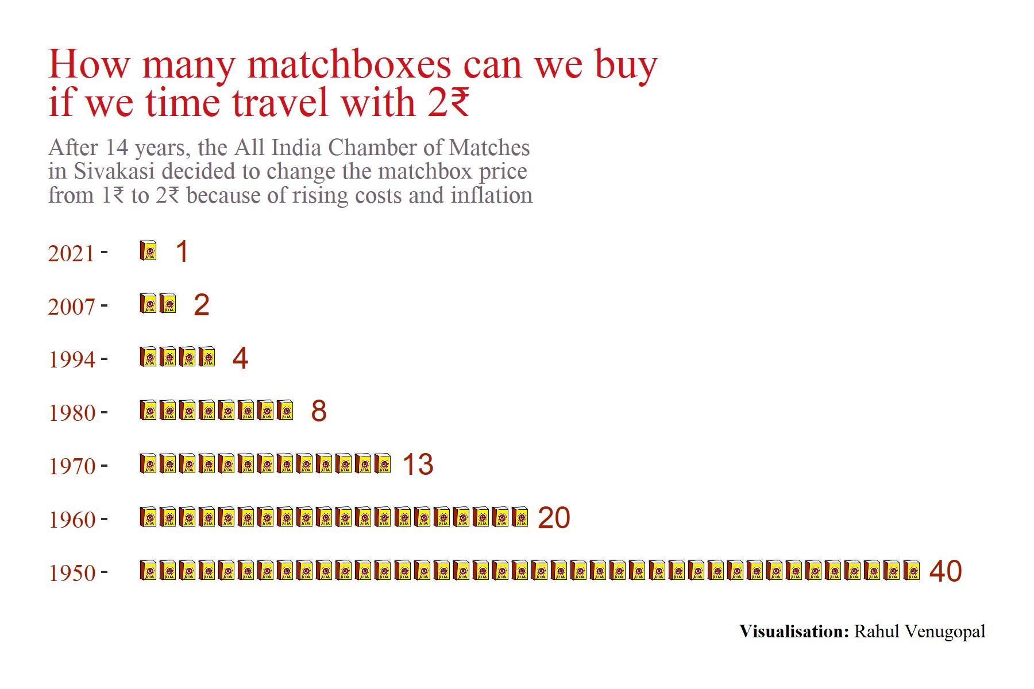

Slide 16
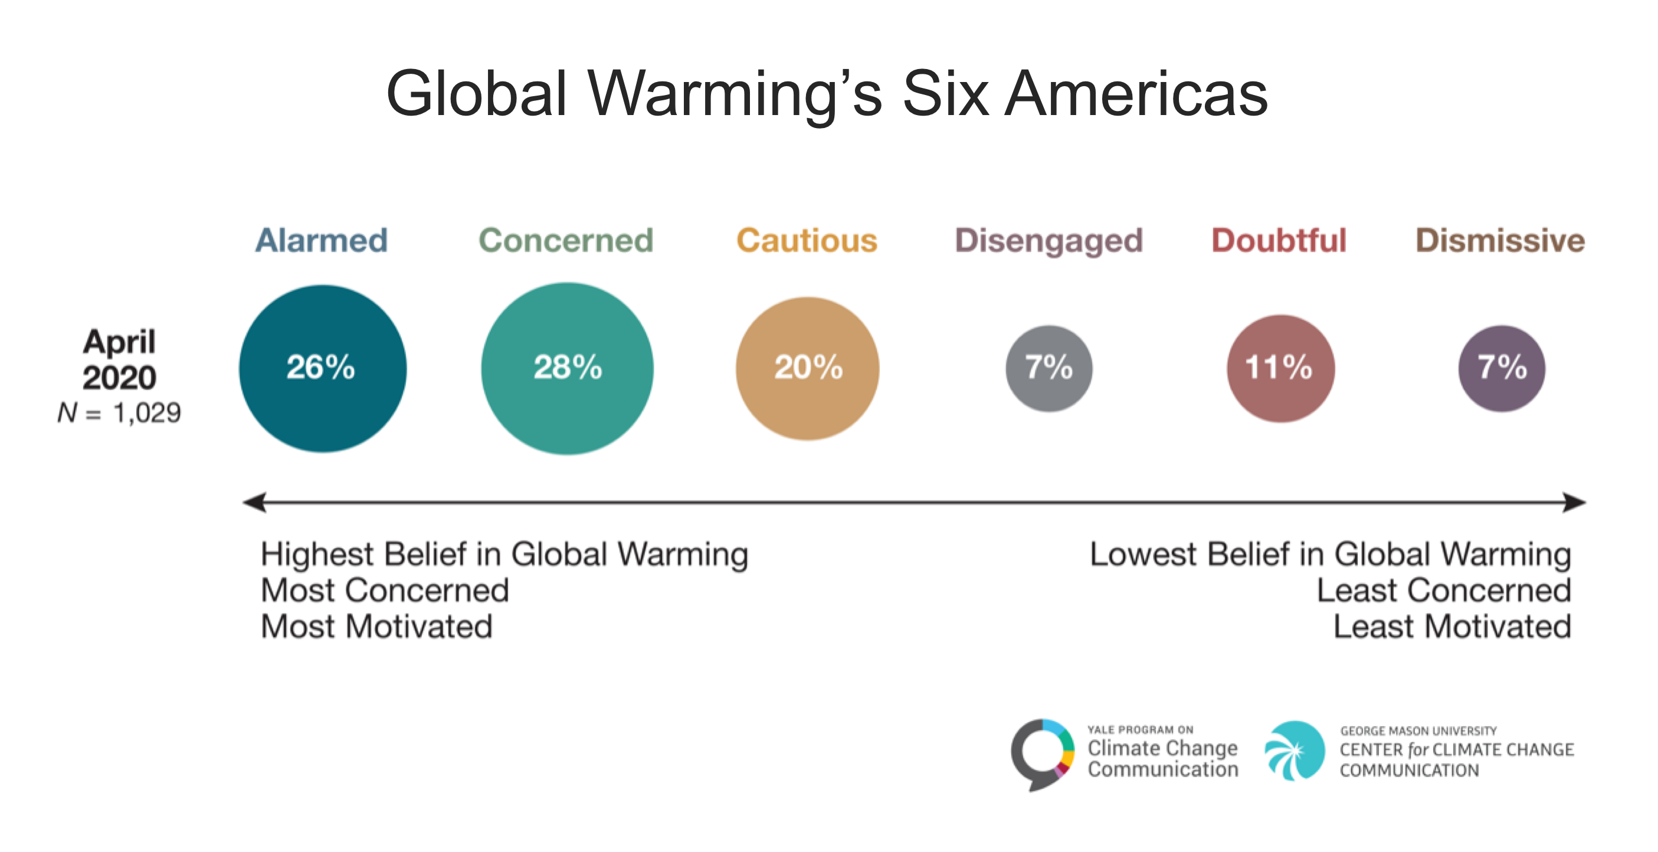
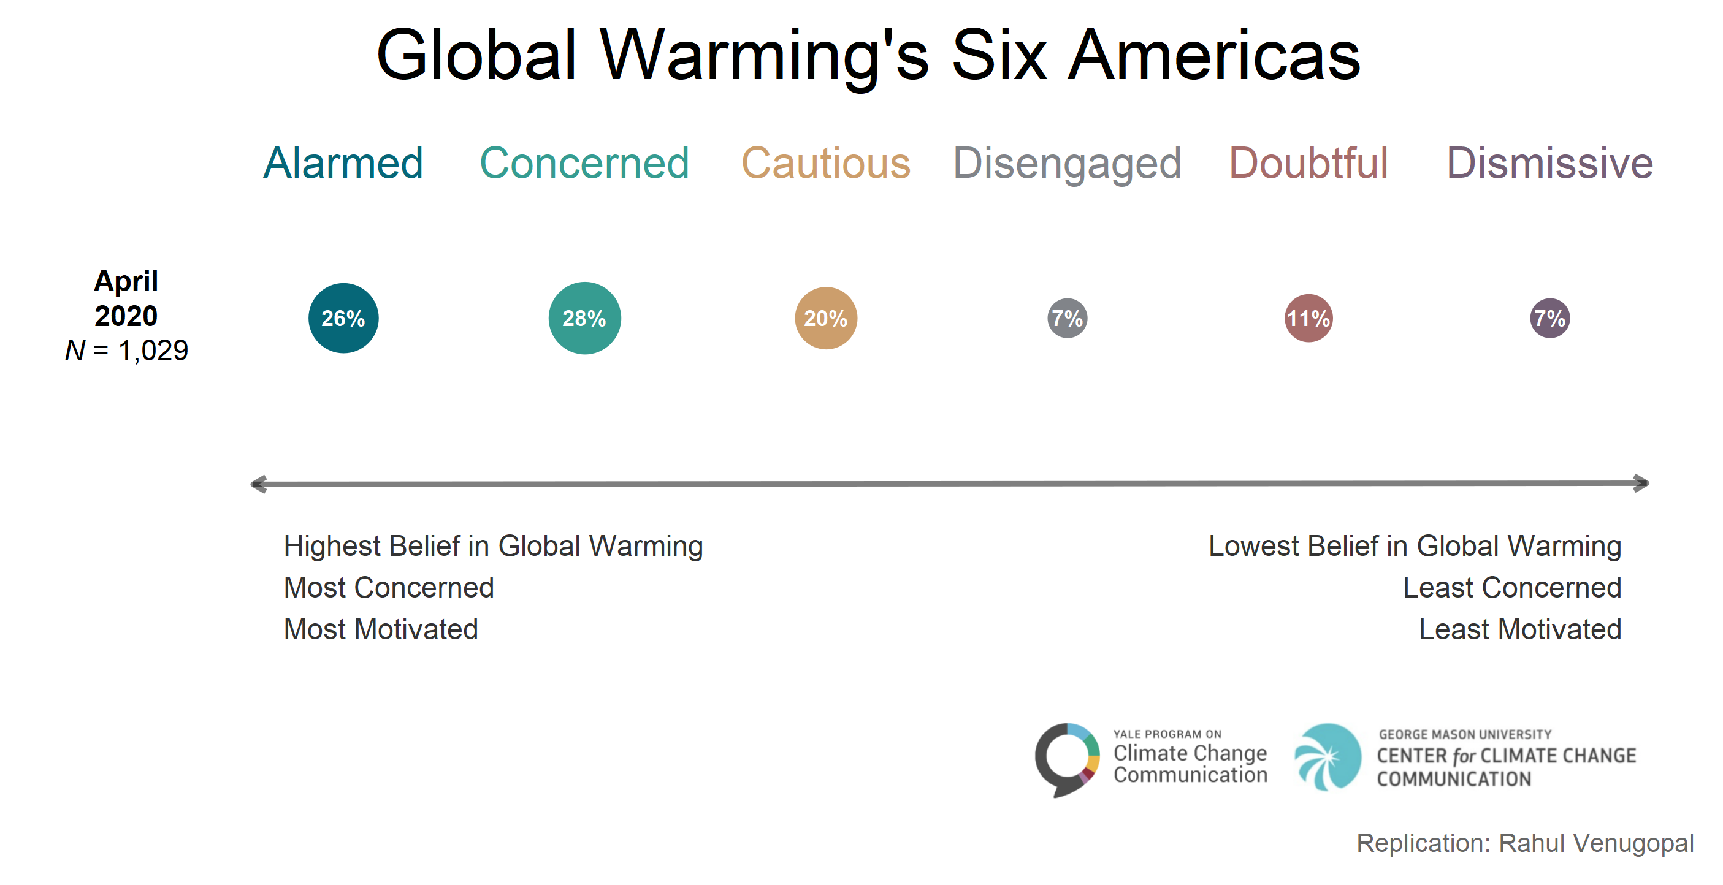

Slide 17
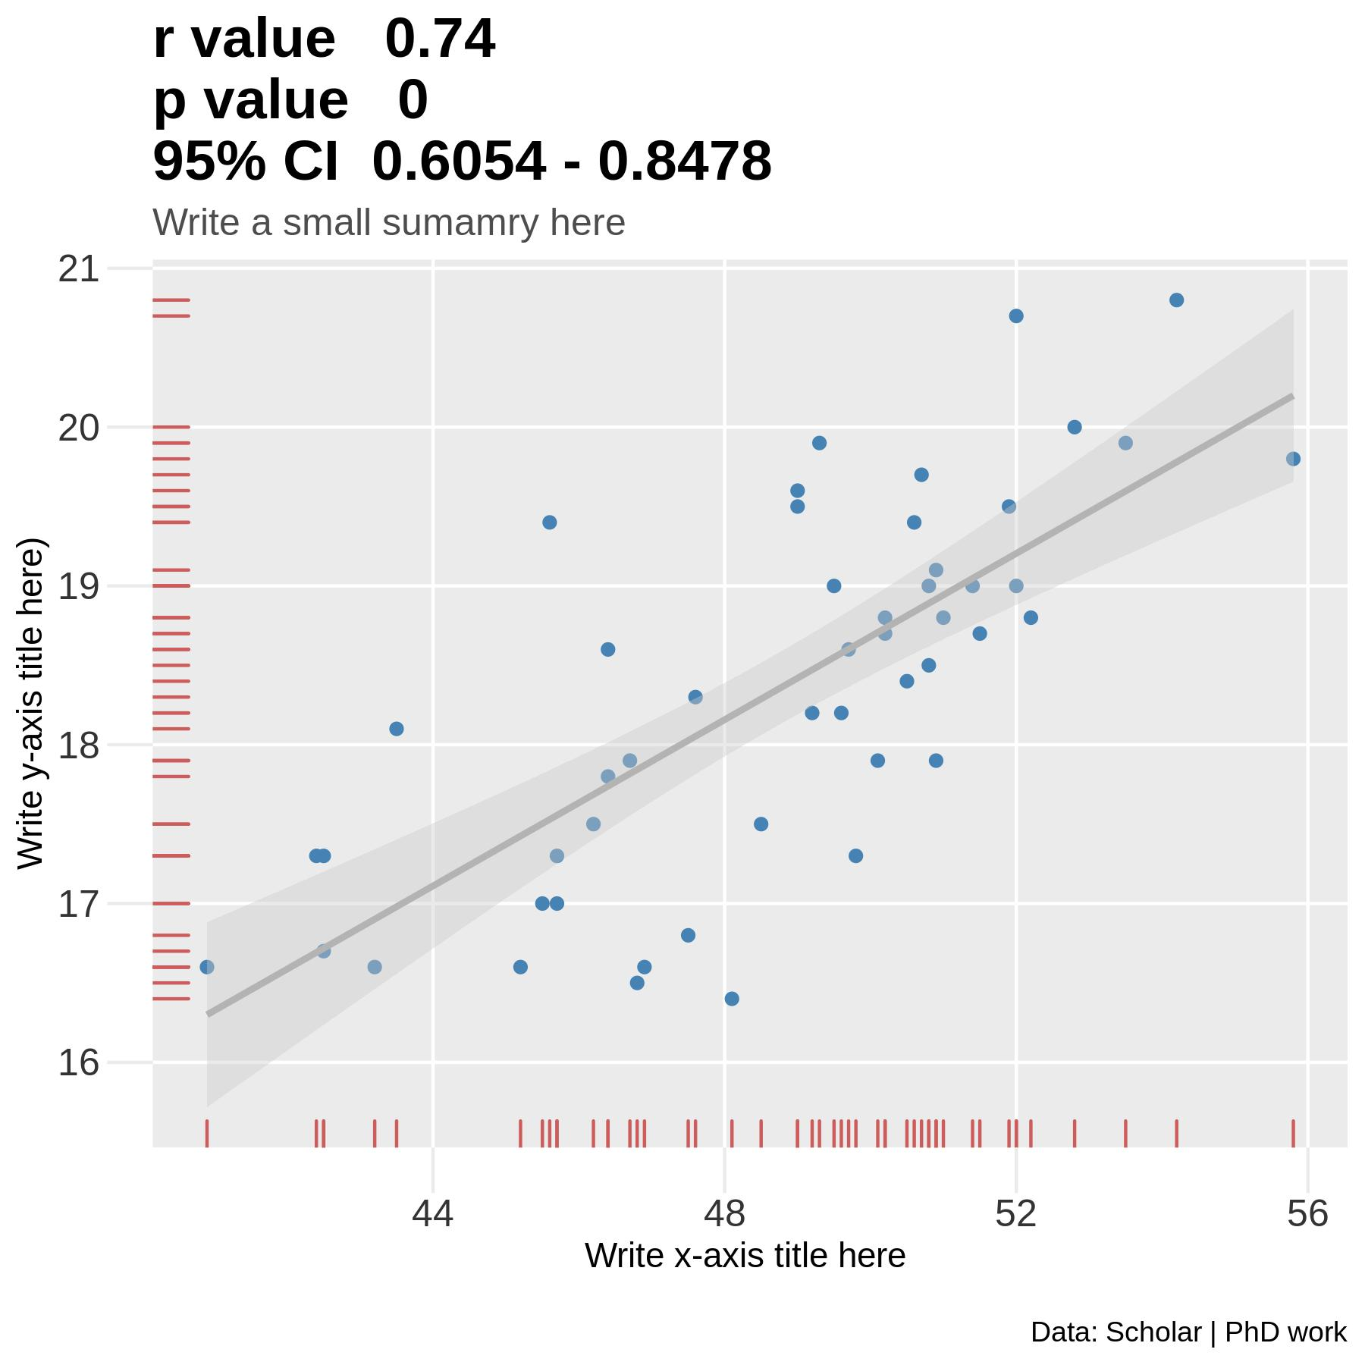

Slide 18
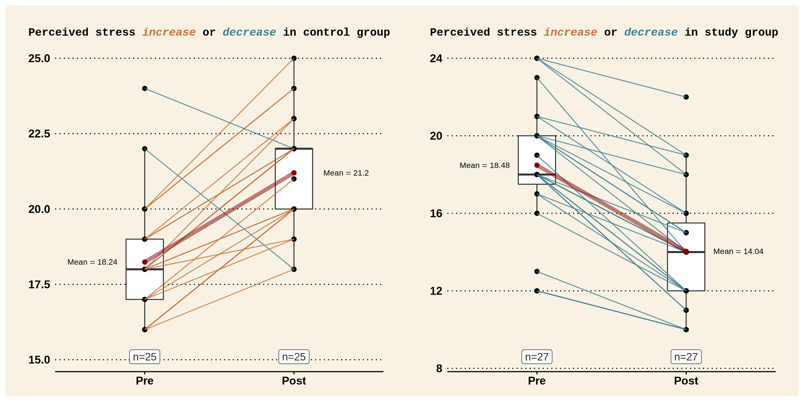
Paired slope lines
Notes:
Scales are not uniform

Slide 19
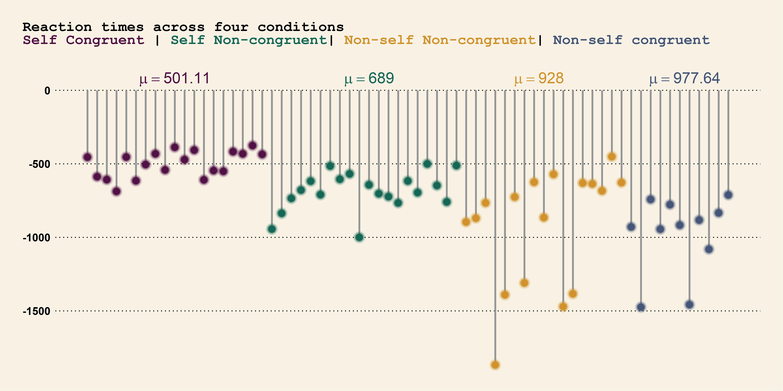

Slide 20
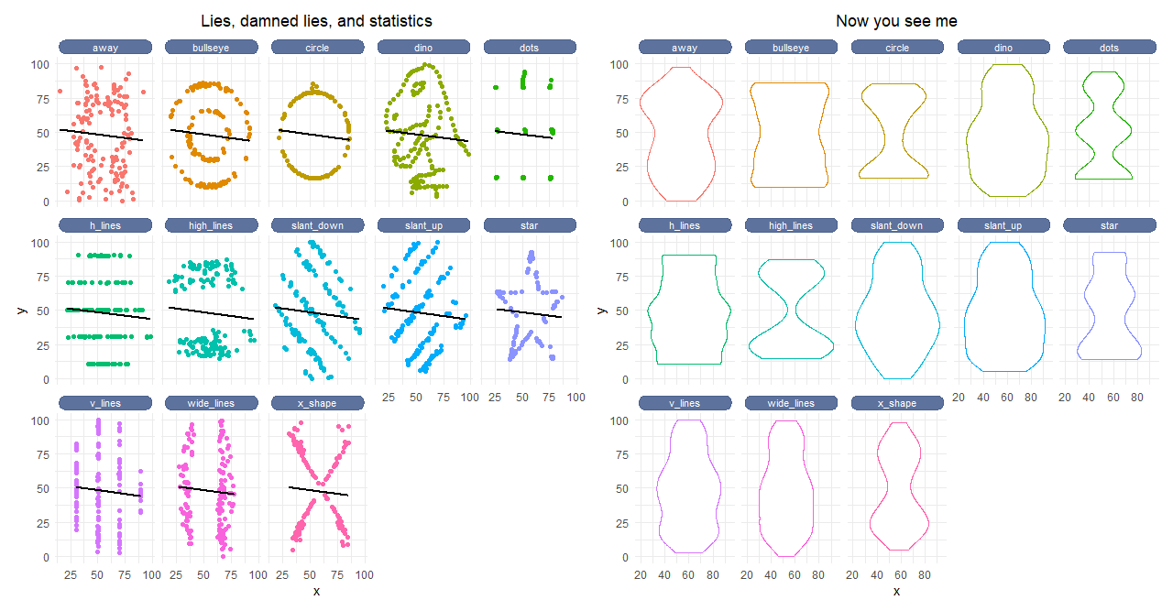
Notes:
Datasaurus dataset

Slide 21

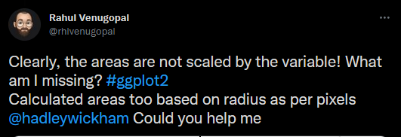
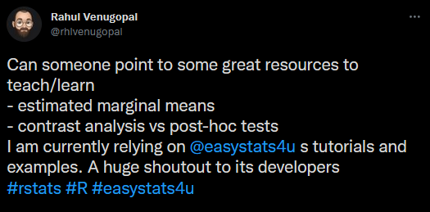

Slide 22
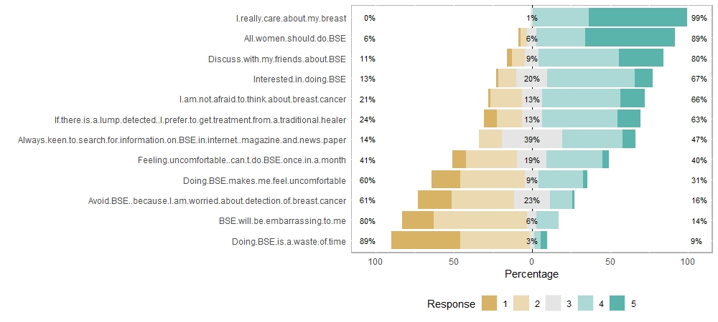
Survey analysis and visualisation

Slide 23
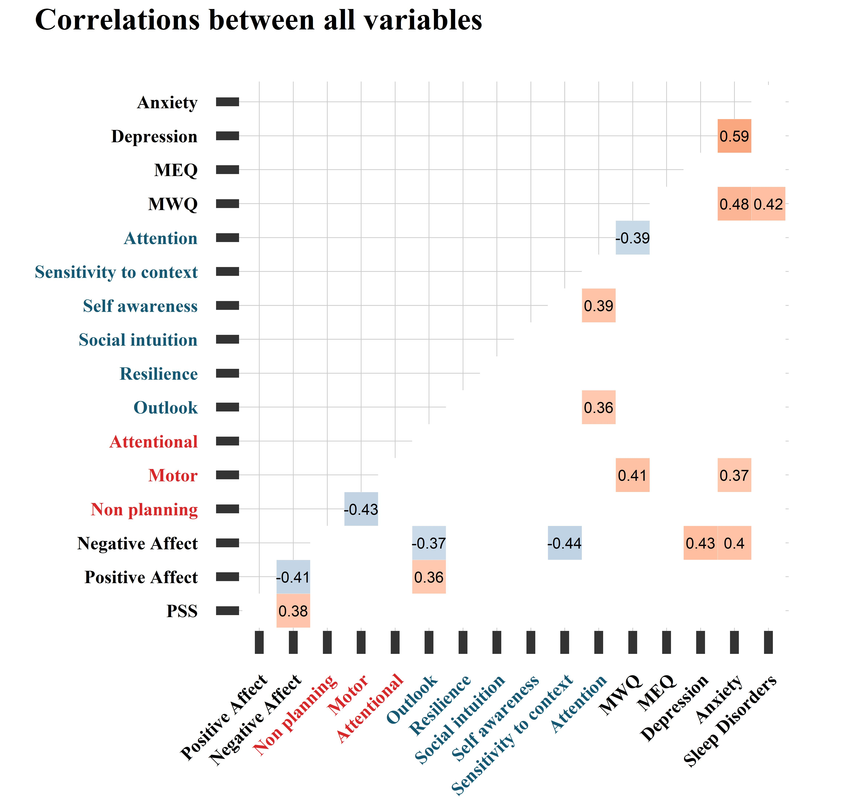
Survey analysis and visualisation

Slide 24
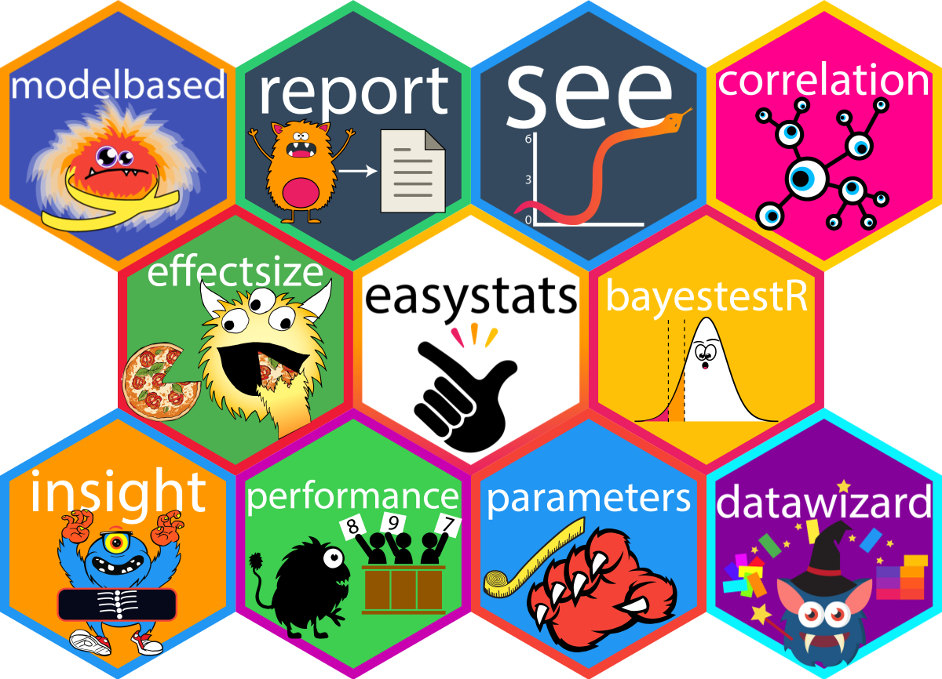

Slide 25
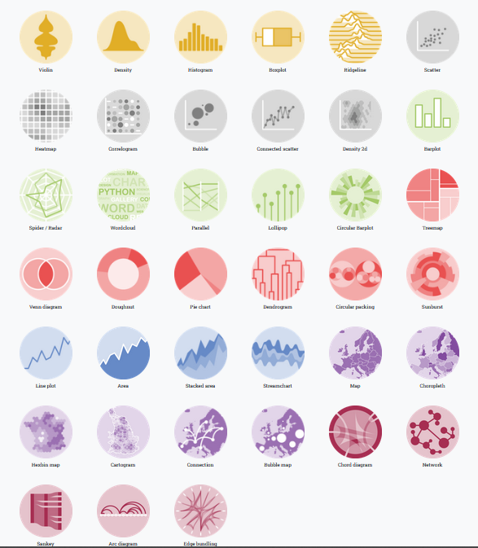
R Graph Gallery
Notes:
https://www.data-to-viz.com/

Slide 26
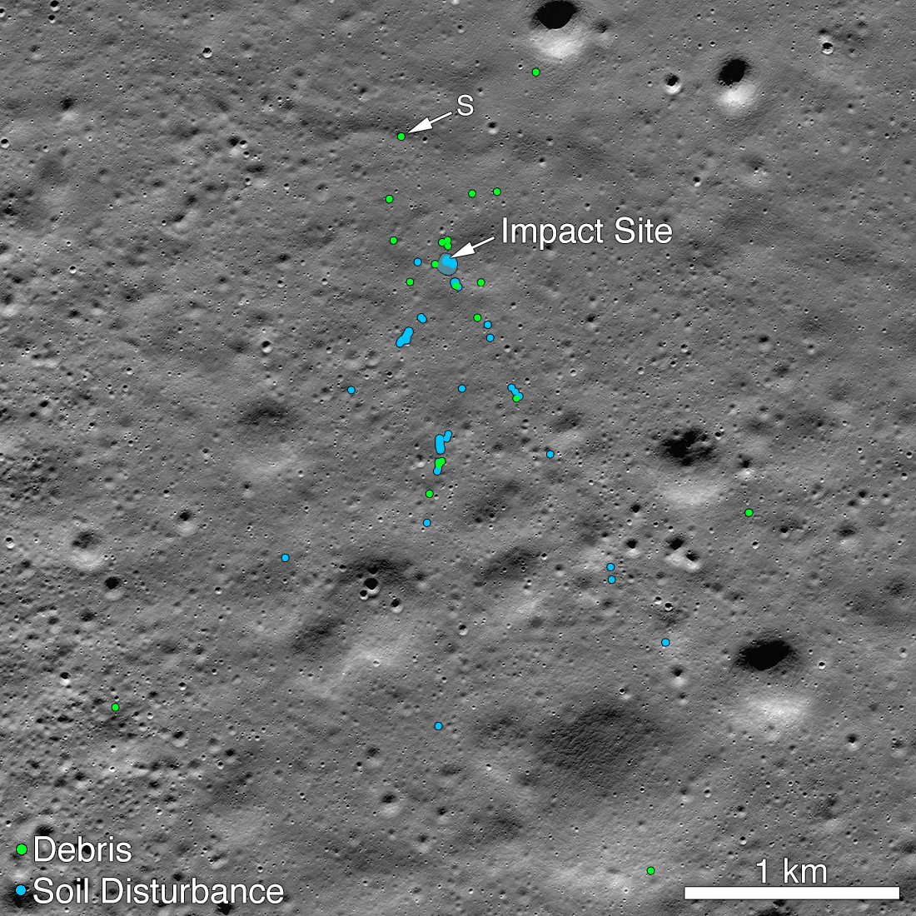
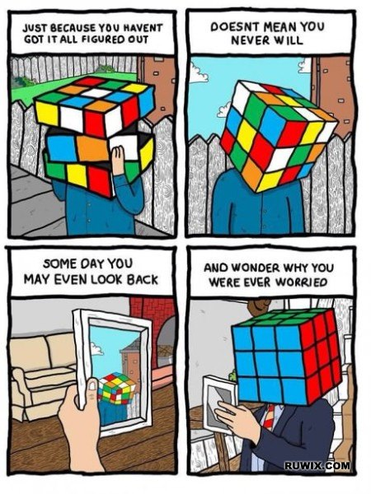
Notes:
September 6, 2019 Vikram moon lander of India | Shanmuga Subramanian | India missed 4th position to soft land on the moon | Open source code in huge project
Chennai runs fb page, he spent 7 hours a day, citizen scientist

